Slide 1
Presentation of
Self-boosted Time-series Forecasting with Multi-task and Multi-view Learning

Slide 2
Motivation
Better decisions
Resource allocation
Notes:
The motivation behind this paper is to make better time series prediction in order to make better decisions in the domain which is to be predicted
This would enable persons, companies, organization and so on, to allocate their resources better and achieve higher efficiency on their resources

Slide 3
Related Work
ARIMA (Box and Pierce, 1970)
ANN with neuro-fuzzy inference system (Emamgholizadeh, Moslemi and Karami, 2014)
Discrete Wavelet Transform (Khandelwal, Adhikari and Verma, 2015)
Combination of EEMD and LSTM (Wu, Wu and Zhu, 2019)
Multi-task learning (Caruana, 1997)
Multi-view learning (Sun, 2013)
Notes:
ARIMA – basic model, failure to capture unusual change of pattern
ANN – Uses ANN with fuzzy logic
All above is focusing on high dimensional data where domain specific features play an important role
In the discrete wavelet transform the time series is decomposed into a linear and a non-linear components, ARIMA is used on the linear part of the dataset, ANN on the non-linear part
In the combination of EEMD (empirical mode decomposition) and LSTM have shown that signal processing methods such as the EEMD could be used in time series forecasting
In multi-task learning, generalization is improved by using signals of related task as inductive bias and this way improve efficiency and prediction accuracy
In multi-view learning, distinct features are used to give an accuracy description of the data and improve the learning performance this way
The authors of this article believes that this is the first paper addressing a way to combine the use of the signal EEMD method and the multi-task, multi-view learning paradigm

Slide 4
Problem Description
Divided into three parts
IMF (intrinsic mode functions)
The input
Problem solution
Notes:
The problem is divided into three parts:
The IMF (intrinsic mode functions). This is any function that has the same number of extrema and zero crossing as the original time series function, and additionally are symmetric with regards to zero
The input is the time series Y = {y1, y2, …, yt} where t is the current time. This time series is decomposed into n IMF functions. Each of these IMF has as many datapoints as the original time series
Our goal is to learn a function f that takes the output of the IMF functions and predict the values of the time series in the h next time steps

Slide 5
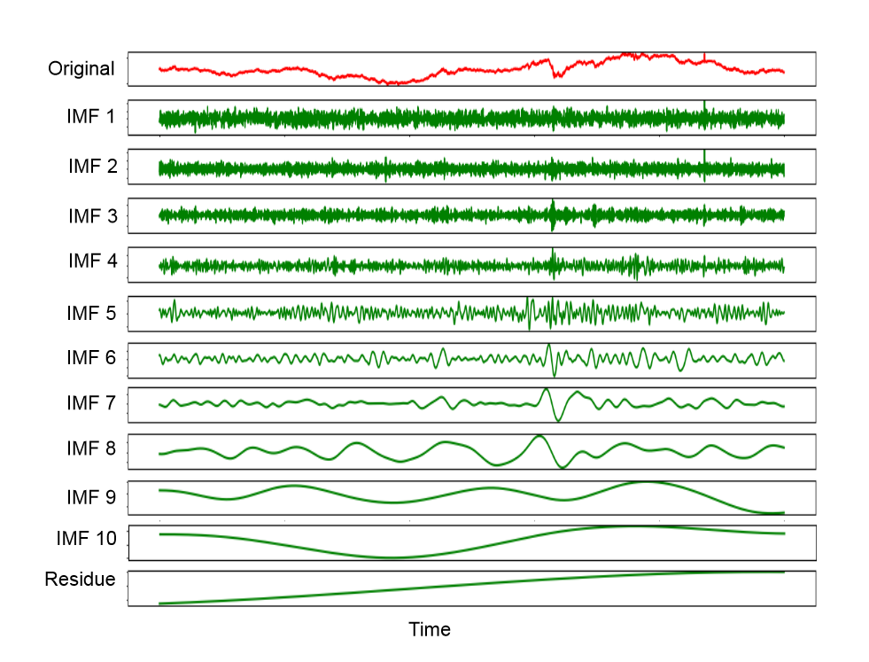
Method
Decomposition
Notes:
Here a time series in decomposed into multiple intrinsic mode functions that is orthogonal and the sum of the functions is equal to the original time series
This is done by using the signal processing EEMD (empirical mode decomposition) algorithm

Slide 6
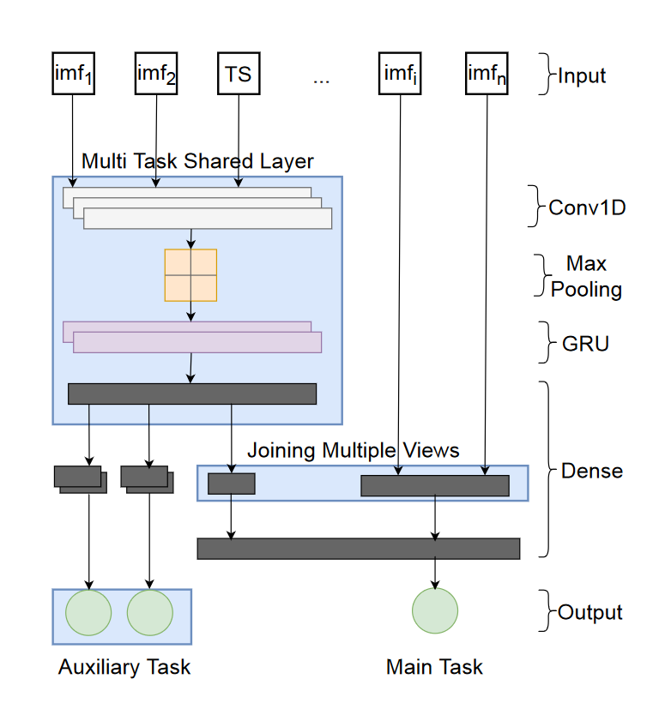
Method
Decomposition
Feature selection
Notes:
We treat each intrinsic mode function as an additional feature to train our model on
We group the intrinsic mode functions into two groups based on their correlation with the original time series, one that consist of the IMF that are most similar with the original time series and the other of those that are the least similar
Then we select the most similar group of intrinsic mode functions and build a multi-task model based on these features, as you can see in the input of the figure

Slide 7
Method
Decomposition
Feature selection
Forecasting model
Notes:
The remaining group of intrinsic mode functions that has a low coloration value with the original time series, is then used as additional views for the main task, which would be the predictions of the model in the time horizon H
The utilization of these functions help boost the performance of the forecasting model
The auxiliary tasks are used to forecast related time series. These could be used as intrinsic mode functions for these time series

Slide 8
Experimental Setting
Three datasets
Electricity
Exchange rate
Air temperature
Four state-of-the-art methods
ARIMA
RNN-GRU
Dilated CNN
Seq2seq
Notes:
In order to mearsure the performance of the model, three datasets where chosen:
One is the electricity consumption in kW for 321 clients that was recorded every 15 minute and then resampled every hour for use in this experiment
The daily exchange rates of 8 countries from 1990 to 2016
The hourly recorded temperature of an Italian city from March 2004 to February 2005
Each of these datasets are then evaluated against each of the four state-of-the-art methods that are listed here, in addition to the self boosted method

Slide 9
Experimental Setting
Four loss functions:
Root Mean Square Error (RMSE)
Mean Absolute Error (MAE)
Mean Absolute Percentage Error (MAPE)
R-squared (R²)

Slide 10
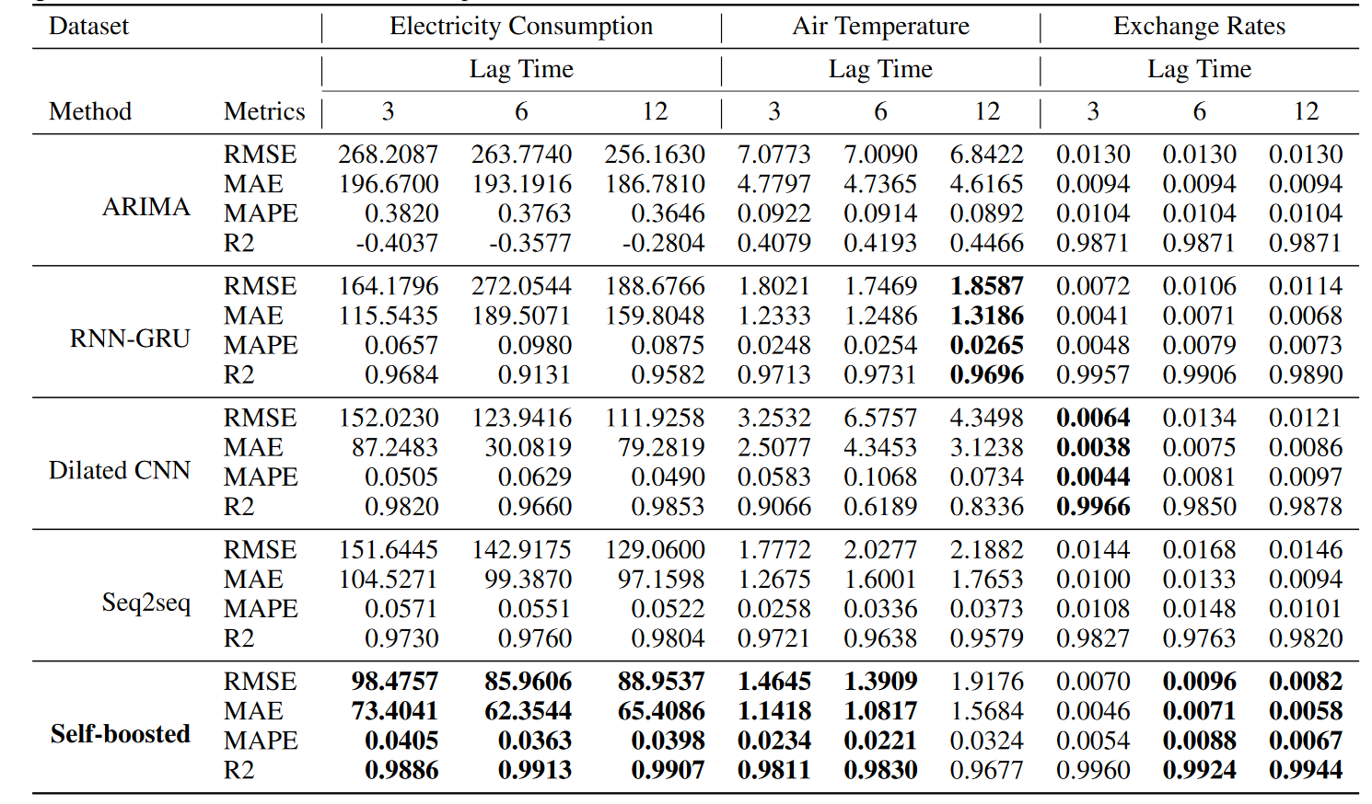
Experimental Results
Notes:
When all of these three datasets, four SOTA methods, four loss functions and the lag time, which is how far into the future the model has predicted, is evaluated together, you get this comprehensive table
However, you could see that the self-boosted algorithm perform best on some of the lag times, and good on the ones where it did not perform best

Slide 11
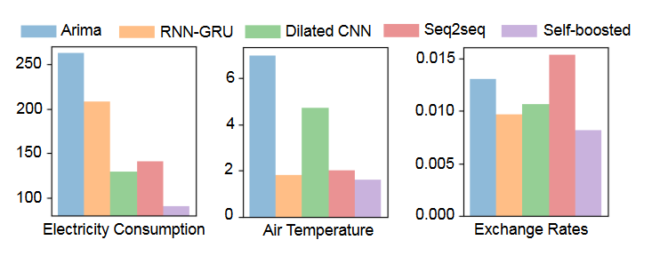
Experimental Results
Notes:
It is easier to see that the RMSE loss is lower for the self boosted method in these tables

Slide 12
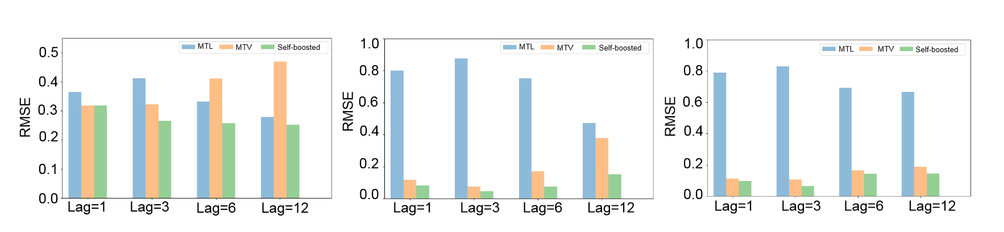
Experimental Results
Against MTL (multi task learning) and MTV (multi view learning)
Electricity consumption Air temperature Exchange rate
Notes:
The self boosted method that contains both the multi-task and multi-view learning is also evaluated against methods that uses only one of them
The result is better when using both models

Slide 13
Conclusions
Use both multi-task and multi-view learning
Make use of EEMD
Outperform other state-of-the-art models
Notes:
Use both the multi-task that learn from related data and the multi-view that learn from less related ones
Make use of the EEMD to divide the original time series into intrinsic mode functions
Given the experimental settings, the model presented in this paper outperform several state-of-the-art models

Slide 14
Sources
https://arxiv.org/pdf/1909.08181.pdf

